Slide 1
DATA SCIENCE
AND
AGRICULTURE
By SYLLA Fatoumata Khalil

Slide 2
What is data science?
How it works?
What methods are used?

Slide 3
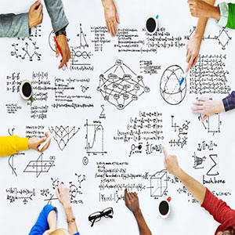
METHODOLOGY USED
Delivering, communicating, and/or presenting final results
Data acquisition, collection, and storage
Business decisions and/or changes are made based on the results
Discovery and goal identification (ask the right questions)
Repeat the process to solve a new problem
Access, ingest, and integrate data
Processing and cleaning data (munging/wrangling)
Initial data investigation and exploratory data analysis (EDA)
Choosing one or more potential models and algorithms
Apply data science methods and techniques (e.g., machine learning, statistical modeling, artificial intelligence, …)
Measuring and improving results (validation and tuning)

Slide 4

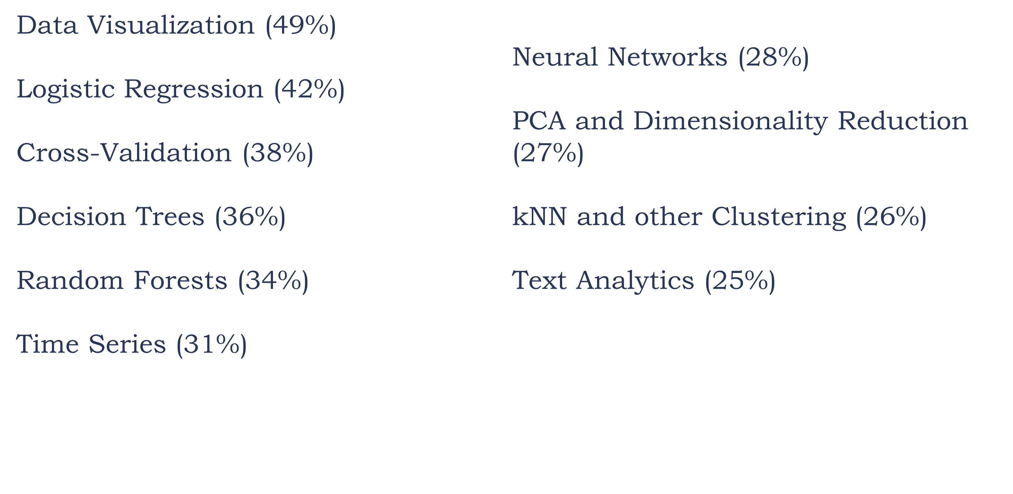
TECHNIQUES AND METHODS USED IN DATA SCIENCE TODAY

Slide 5
FUTURISITIC METHODS AND TECHNIQUES
41%
13%
6%
5%
5%
Deep Learning
Neutral nets
Text mining
Time series
Bayesian methods

Slide 6
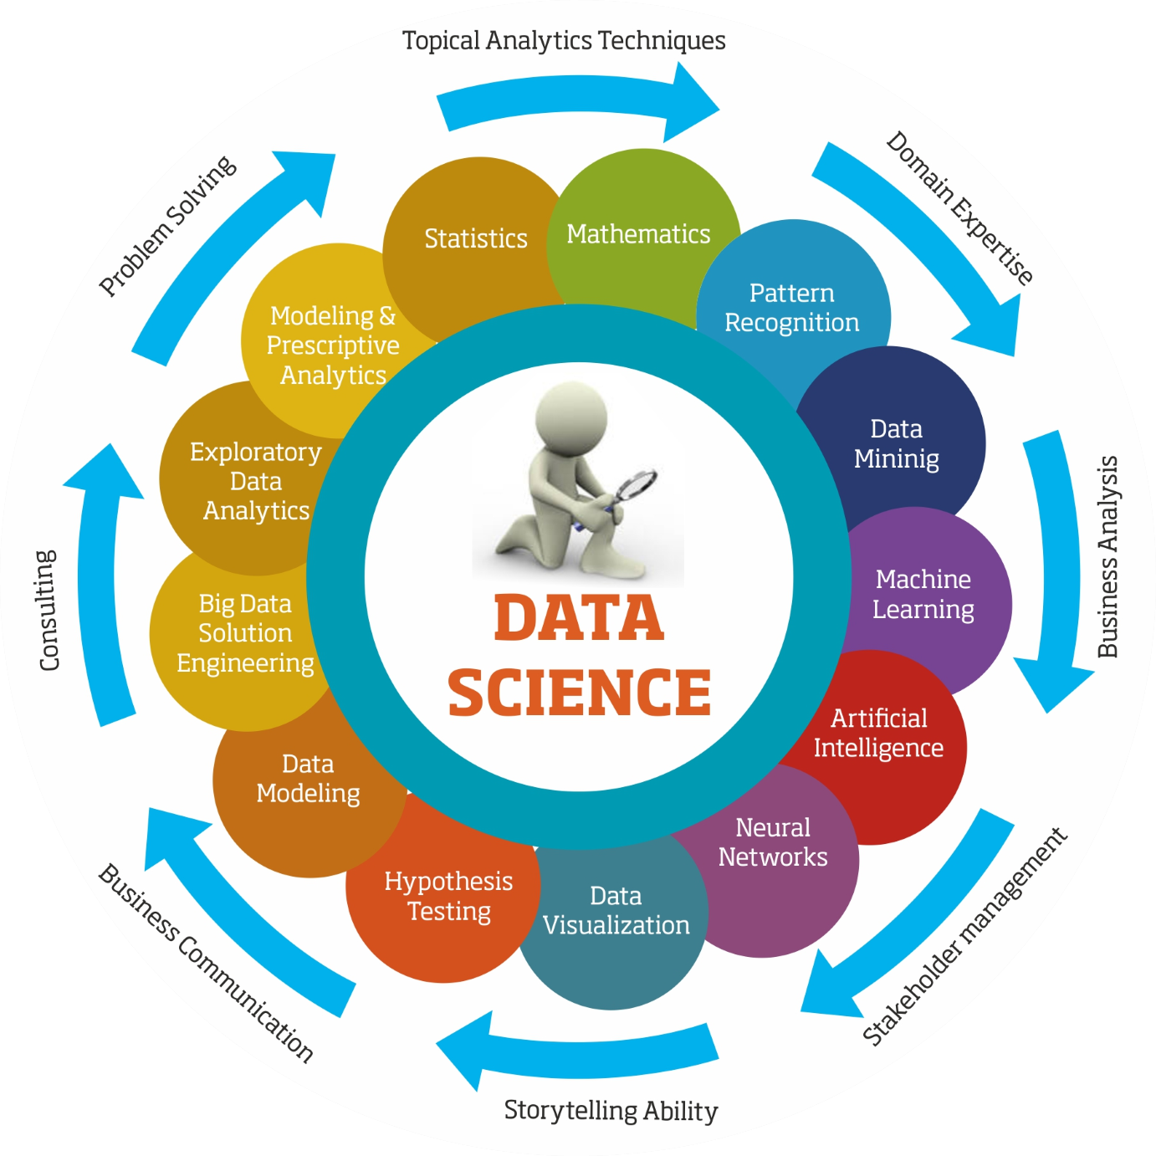
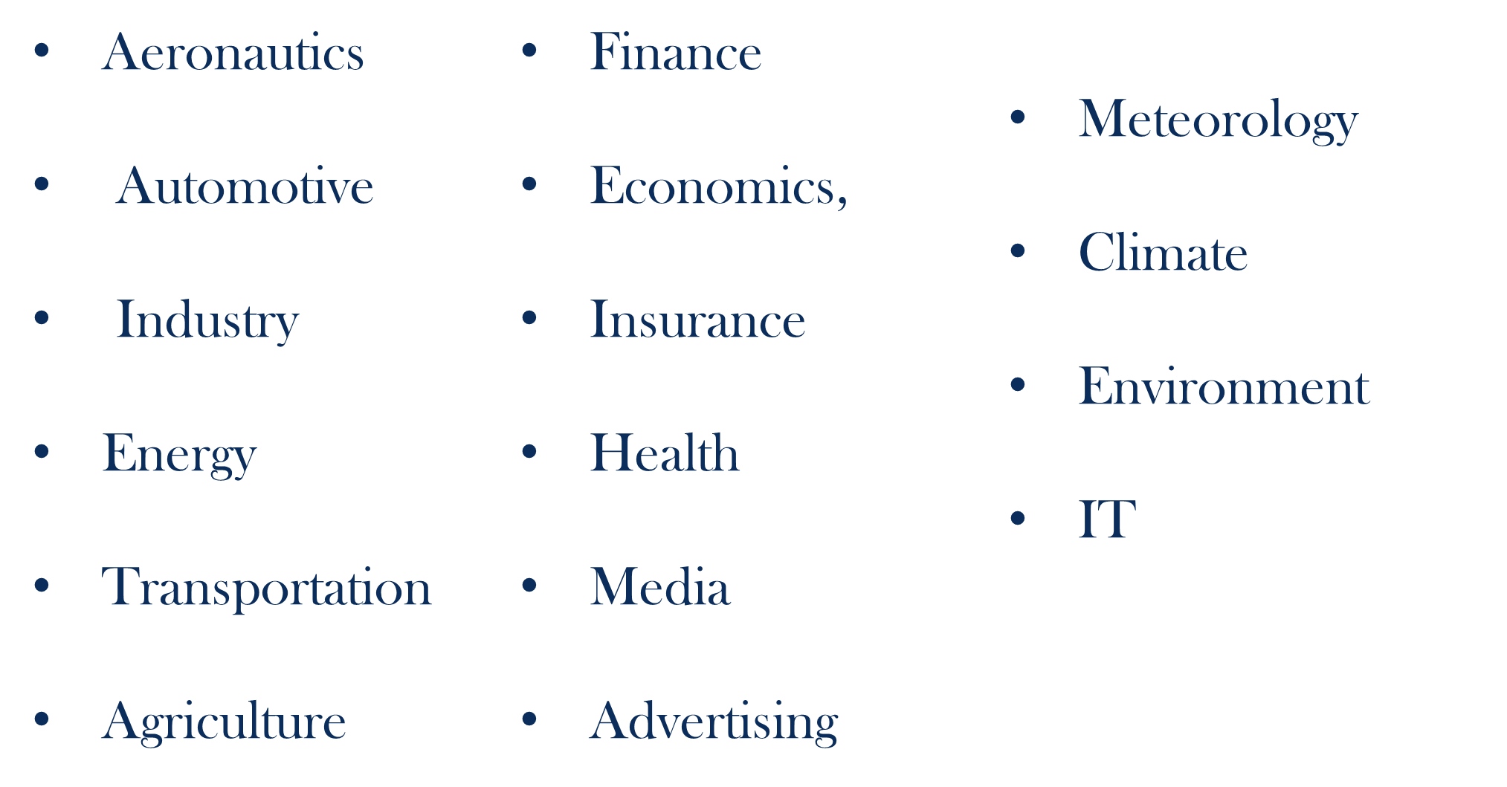
Data science has an impact in the real world, on all the domain of activities

Slide 7
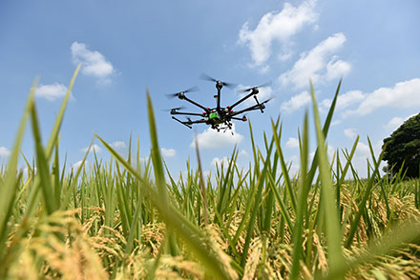


DATA SCIENCE IN AGRICULTURE
‘’ Data-Driven Precision Agriculture’’
Challenge: ‘’Field on a sustainable base a population of 10 billion with the use of technology’’

Slide 8
WHY DATA SCIENCE IN AGRICULTURE?
The advantage that data scientists can offer over traditional predictive models is that their data sets can extend far beyond human memory, and even human existence, and tap into records inscribed in the stones across the geologic time scale. Data from previous eons, when the Earth underwent similar changes, can be factored into models and used to provide more accurate predictions for the agriculture industry to use for planning.

Slide 9
Revolution in Agriculture
1960
Green Revolution
1980
Biotech revolution
2010
Green Data Revolution with usage of technology
USE OF DEEP LEARNING
Deep learning algorithms can take a decade of field data—insights about how crops have performed in various climates and inherited certain characteristics—and use this data to develop a probability model. With all this information, far more than any single human can grasp, machine learning can predict which genes will most likely contribute a beneficial trait to a plant. Of the millions of combinations, advanced software greatly narrows the search.
.
A typical example ‘’SEE AND SPRAY’’
See & Spray uses similar algorithms to those in facial recognition software, and is “trained” on tens of thousands of images to distinguish weed from crop. It makes 5,000 decisions each minute, and has an accuracy to within 63mm

Slide 10
MAIN APLLICATIONS
ROBOTICS IN AGRICULTRE
(use of AI to create robots to perform the tasks)
PREDICTIVE ANALYSIS FOR MANAGEMENT DECISIONS
(Yield, soil, ….)
USE OF VIDEO RECOGNITION
(distinguish weed from crop, detect sicknesses, ...)

Slide 11
Thanks!
Any questions?

